Slide 1




School of Mechanical Engineering
Course Code : BME01P1001 Course Name: Engineering graphics & introduction to digital fabrication
TOPIC-PROJECTION OF SOLID- CYLINDER,CONE AND PRISM
Name of the Faculty: Dr. KK Dubey Program Name: B.Tech-1ST Year

Slide 2



Learning Outcome
STUDENTS WILL BE ABLE TO LEARN ABOUT-
Engineering solids and its types.
Projection of solids at different positions

Slide 3

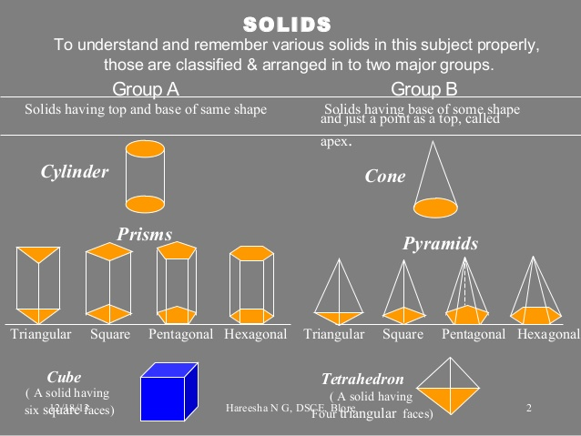

SOLIDS

Slide 4

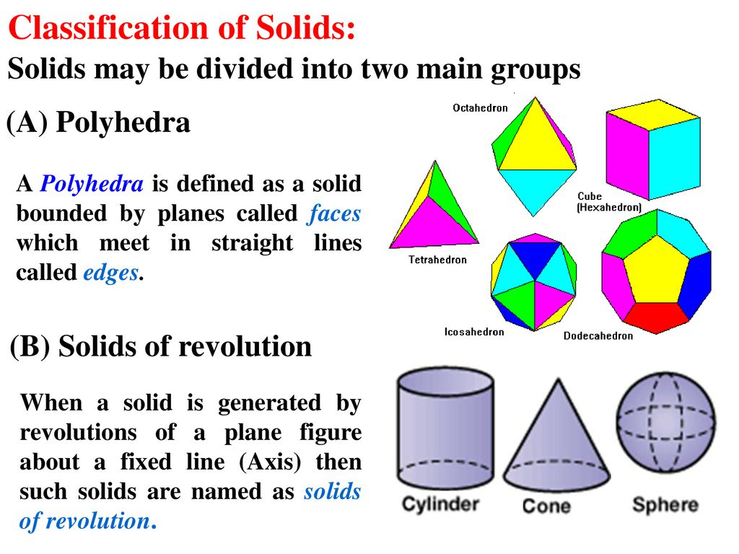
SOLIDS CLASSIFICATION

Slide 5

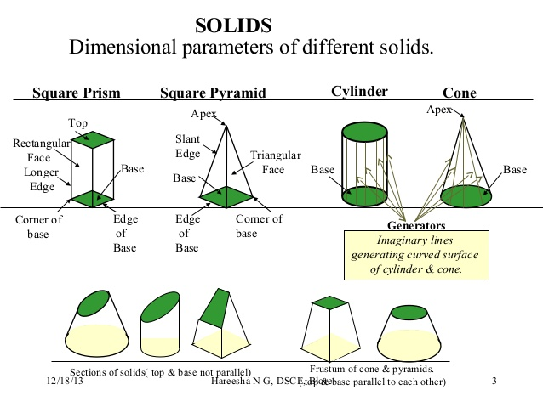
Dimensional parameters of solid

Slide 6
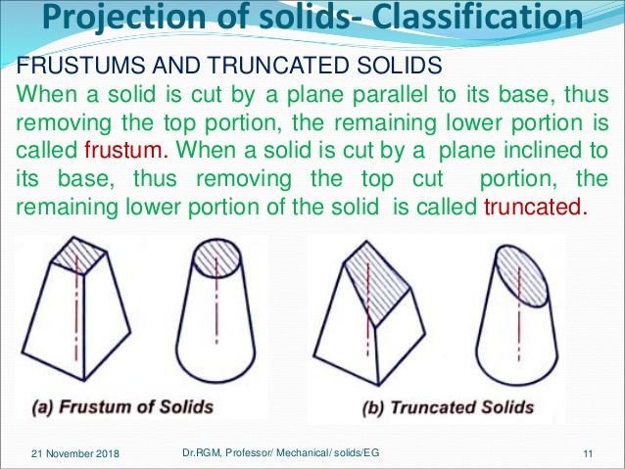
FRUSTUMS AND TRUNCATED SOLID

Slide 7
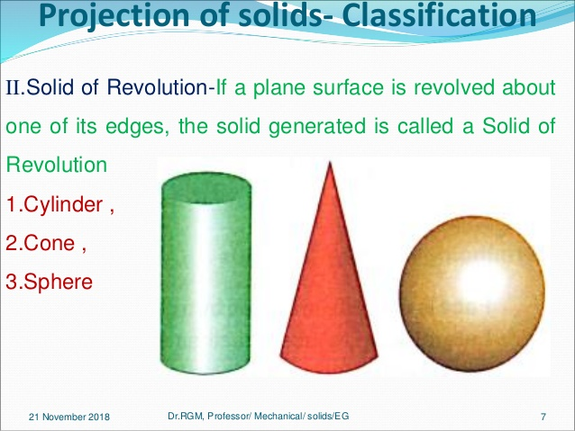
REVOLUTION OF SOLID

Slide 8
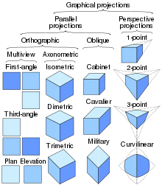
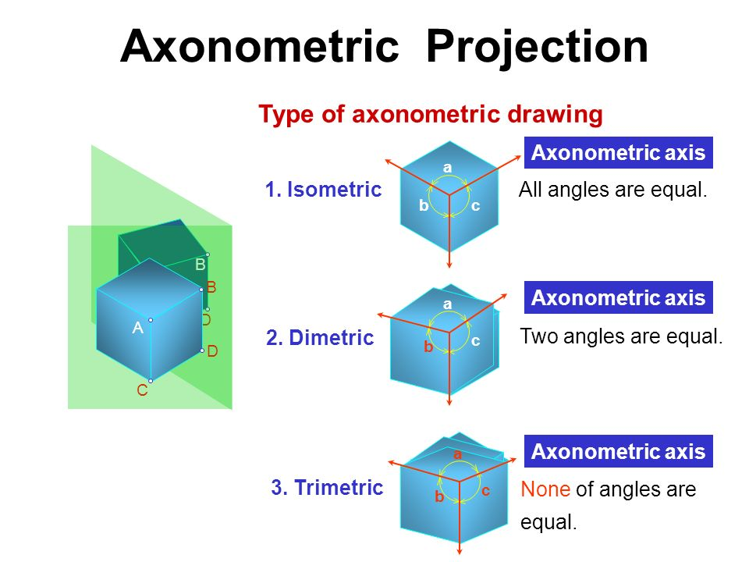
PROJECTION OF SOLID
Notes:
8

Slide 9
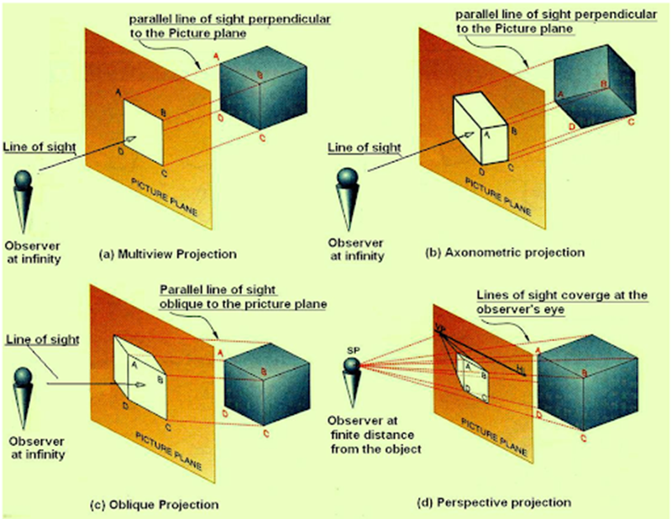
Actual Vapor-Compression Cycle
PROJECTION OF SOLID
Notes:
9

Slide 10
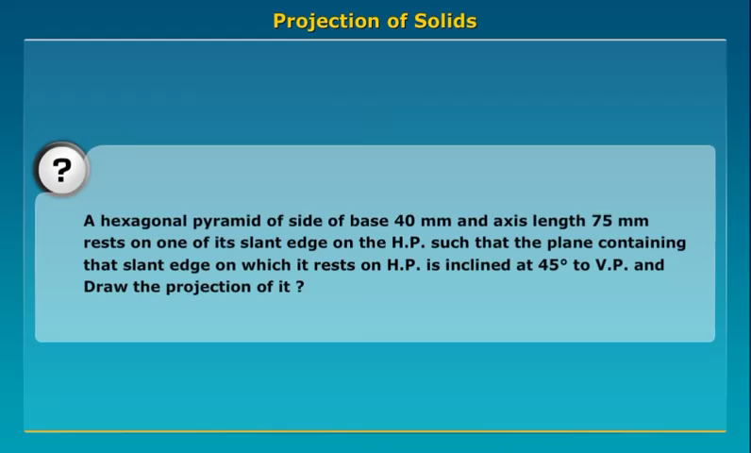
Actual Vapor-Compression Cycle
CONCEPT VEDIO-HEXAGONE PYRAMID PROJECTION
SOURCE-https://www.youtube.com/watch?v=Fn6y786kwRA
Notes:
10

Slide 11
Actual Vapor-Compression Cycle
Cone Projection
Problem-1-A cone with base diameter 50 mm and axis 60 mm rests on HP on a base point such that the axis is parallel to VP and inclined at 30° to HP. Draw its projections
PROCESS
Stage 1
The cone is kept on its base on the H.P. so that the axis will be perpendicular to the H.P.
1 – Draw the horizontal centre and vertical centre line. The meeting point of axis line, taking the radius 30 m.m for construction of a circle of diameter 60 m.m to represent the T.V of the cone. Mark apex o at the centre. Divide the circle into 12 equal parts and mark them as a,b,c,d,e,f,g,h,- - - - l .
2 – Draw a triangle a - g – 0’ of height 60 m.m to represent F.V of the cone. Project a,b,c etc. To a’.
Stage ii
The cone is now tilted about a point on its circumference such that a generator will fall on the HP.
3 – Redraw FV in such a way that edge 7’ – 0’ will coincide with XY. Relocate points 1’, 2’, 3’; etc’ on 1’ -7’ by using a divider.
4 – Project 1’, 2’, 3’, etc ., from FV to intersect the projectors through 1,2,3, etc., to obtain 11,21,31, etc.,
Join 11, 21, 31, etc. to obtain elliptical base. Also obtain o1 in a similar way.
5 – Join o1 to the ellipse by drawing two tangent lines. The view represents the required TV.
Notes:
11

Slide 12
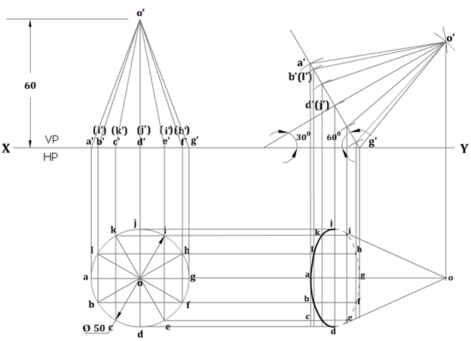
Actual Vapor-Compression Cycle
Cone Projection
Problem-1-A cone with base diameter 50 mm and axis 60 mm rests on HP on a base point such that the axis is parallel to VP and inclined at 30° to HP. Draw its projections
Notes:
12

Slide 13
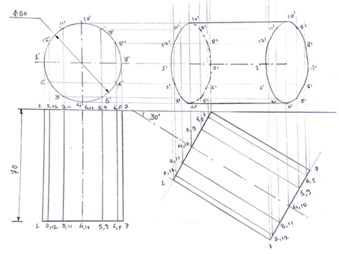
Actual Vapor-Compression Cycle
Cylinder Projection
Problem-2-A cylinder of 50 mm diameter of base and 70 mm length of an axis is resting on one of the points on circumference in the VP. Draw its projections if one of the generators is inclined at 30 ̊ to the VP
Notes:
13

Slide 14
Practice Question
Q1-A cube of 50 mm long edges is so placed on HP on one corner that a body diagonal is
Parallel to HP and perpendicular to VP. Draw it’s projections.
Q2-A cone 40 mm diameter and 50 mm axis is resting on one of its generator on HP which makes 300 inclinations with VP. Draw it’s projections.
Q3-A hexagonal prism, having a base with a 30mm side and an 80mm long axis, rests on one of its base edges in the H.P such that the axis is inclined at 300 to the HP and 450 to the VP. Draw its projections?

Slide 15

References-
1. K C John (2009), Engineering Graphics for Degree, Prentice Hall of India. ISBN: 978-8-120-33788-3.
2. P N Rao (2010), CAD/CAM Principles and Applications, 3rd Edition, Tata McGraw-Hill Education, ISBN: 978-0-070-68193-4.
3. French, Thomas E.; Vierck, Charles J., A manual of engineering drawing for students and draftsmen (8th ed.), New York, New York, USA: McGraw-Hill, LCCN 52013455.
Name of the Faculty: Dr. KK Dubey Program Name: B.Tech-1ST Year

